Slide 1
Microsoft Azure Logic Apps

Slide 3
How to View This Presentation
All slides have two styles of PDF documents:
Full View – full page view per slide
Notes View – 3 slides per page with ruled lines used to take notes
Use Adobe Reader or other PDF viewing tools to review the PDF slides
All PDF slides are located in your <…> file

Slide 4
Introduction and Logistics
Your trainer
You
Your role
Your company
Your experience in this technology area
Your goals for this workshop
Start and end times
Facilities (bathrooms, smoking)
Meals
Computers, phones, tablets, etc.
Please set your phones to vibrate
What’s on your desk?

Slide 5
Logic Apps Agenda
Overview
Development
Exceptions and Error Handling
Workflow Definition Language
Deployment
Monitoring
Security
Enterprise Integration Accounts (B2B)
Integration Service Environments (ISE)
Notes:
Go over the objectives for the module

Slide 6
Introduction to Logic Apps Logic Apps Overview
Notes:
https://docs.microsoft.com/en-us/azure/logic-apps/logic-apps-overview

Slide 7
What is Azure Logic Apps?
An Azure service used to build solutions that integrate apps, data and systems…
Notes:
Built-in actions, for example, actions that call HTTP, Azure Functions, or API Management, as well as control flow steps, are metered as native actions and have their respective types. Actions that call connectors have the "ApiConnection" type. Connectors are classified as either standard or enterprise connectors, and are metered at their respective pricing.
Custom connectors – not just ability to call any API or create custom connectors in code, but now no-code ability to create custom connectors from the portal
Integration account connectors are for more specialized tasks, for example, for working with XML or business-to-business message exchange, for example, X12, EDIFACT, and encoding and decoding flat files. If you've used this tool before, many of the things that you would typically do with an on-premises BizTalk server can also be done here with integration account connectors.
It is also a good fit for when you want to connect an on-premises BizTalk server with Azure Logic apps in the cloud. The next level is enterprise connectors. Enterprise connectors are for connecting to very specific, enterprise-based services, things like SAP, things like MQSeries, and so forth. Both integration account connectors and enterprise connectors come at an additional cost.
If you’re dealing with customers who have BizTalk, integration account is a “must-know”

Slide 8
Example uses of Logic apps
Process and route orders across on-premises systems and cloud services
Move uploaded files from an SFTP or FTP server to Azure Storage
Send email notifications with Office 365 when events happen in various systems, apps, and services
Monitor tweets for a specific subject, analyze the sentiment, and create alerts or tasks for items that need review
Respond to Webhook calls
Process batch operations
Integration of business partners with EDI, AS2
Notes:
When it comes right down to it, Logic Apps is about organizing the flow of a process, similar to a workflow (but this is not the new version of Windows Workflow Foundation)

Slide 9
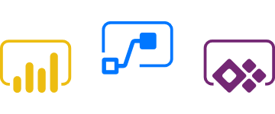

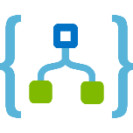

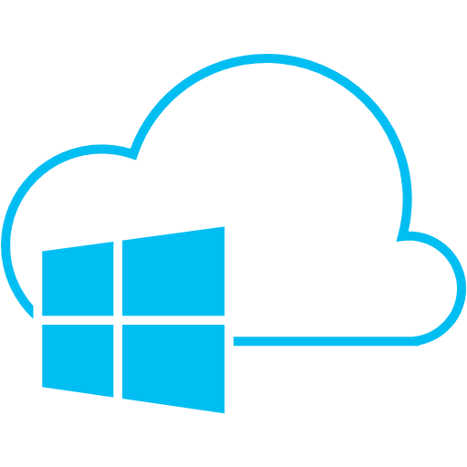

Microsoft Enterprise Integration Platform
Microsoft Flow
Enable the Citizen Developer to Do More
API Management
Document and catalog LOB APIs Discover, manage and secure connectivity Gain insights, measure and monetize
Logic Apps
Connect SaaS applications Serverless compute, auto scaling, fully managed Leverage Azure Services
BizTalk Server
Automate mission critical processes Integrate on-premises LOB to SaaS apps Support for latest Microsoft Platforms
Service Bus
Cloud-based messaging service Connect to the cloud Secure and predictable message delivery
Azure
Management Portal, Azure Resource Manager
Notes:
At a high-level view, Logic Apps fits in to the overall spectrum of what Microsoft considers to be the ‘Microsoft Enterprise Integration Platform’.
Our focus in this module is Logic Apps and we will discuss how Logic Apps fits in to this platform
<click> API Apps are a way of managing API endpoints, developer access to APIs, full monitoring and analysis of the use of APIs
<click> Logic Apps, our focus, is a way to create a workflow with connectors that connect systems together to leverage other Azure services
<click> BizTalk Server – an on-premises LOB application integrator that can integrate B2B solutions, map documents between systems and it also has its own workflow and rules engine
<click> Service Bus – Azures Enterprise solution that has queues, topics and subscriptions for pub/sub, event hubs for high data throughput
<click> Microsoft Flow – an end-user mechanism that can be used to create a workflow through an easy user interface. These workflows can integrate with any of the items below it
<click> All of the items above can be accessed through the Azure portal or Resource manager templates (ARM)
<click> Focus – Logic Apps

Slide 10
Microsoft Workflow Technologies
Logic Apps / Microsoft Flow
Durable Functions
Windows Workflow Foundation (WWF)
Workflow Manager
Sharepoint Workflow
Azure Data Factory (ADF)
Windows PowerShell Workflow
Notes:
Before we start talking specifically about Logic Apps, explain the current workflow technologies, because people see Logics Apps as a replacement for Windows Workflow Foundation
<click> Microsoft flow – end user workflow creation tool. Sits on top of Logic Apps, you can create logic app endpoints that can be accessed when building your workflow in MS flow. Logic Apps is for developers, not end users
<click> Durable Functions – discussed in the Functions session, allow you to create a process that can pause/restart etc. This allows for long-running processes that can go to sleep
<click> Windows Workflow Foundation – a workflow and tool framework built several years ago. Very powerful but made mostly for on-premises applications, not migration to cloud capability. It is still supported and bug fixes, but that is all. WWF, although old, is still more powerful than Logic Apps
<click> Workflow Manager – a hosting mechanism that was pulled out of the SharePoint workflow engine. This manager focuses on hosting running workflows at high scale. Still supported but no enhancements or path forward
<click> SharePoint Workflow – very similar to Microsoft Flow, but inside of SharePoint. Made for the PowerUser to build workflow, can interface with components although not built for the cloud. Underneath the covers, uses WWF and Workflow Manager
<click> Azure Data Factory – good for creating a flow for data in and out of databases, caches etc. Primary focus is data movement.
<click> Windows PowerShell Workflow – underneath the covers, uses WWF. Primarily used for PowerShell automation scenarios on-premises and in Azure automation

Slide 11
Microsoft Flow vs. Logic Apps
Flow and Logic Apps are both configuration-first integration services
Easy to build processes and workflows
Flow is built on top of Logic Apps
Both have the same workflow designer
Connectors share the same capabilities
Flow is generally used by office workers for simple integration flows, no developer or IT staff involved
Logic Apps enable advanced integrations at enterprise level, good for workflow processes that grow over time
Typically you would start with Flow and then move to Logic Apps as complexity increases
Notes:
We can discuss Microsoft Flow and Azure Logic Apps together because they are both configuration-first integration services, which makes it easy to build processes and workflows and integrate with various SaaS and enterprise applications. +
Flow is built on top of Logic Apps
They have the same workflow designer
Connectors that work in one can also work in the other
+
Flows empowers any office worker to perform simple integrations (e.g. get SMS for important emails) without going through developers or IT. On the other hand, Logic Apps can enable advanced or mission-critical integrations (e.g. B2B processes) where enterprise-level DevOps and security practices are required. It is typical for a business workflow to grow in complexity overtime. Accordingly, you can start with a flow at first, then convert it to a logic app as needed.

Slide 12
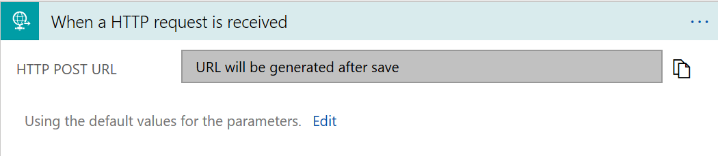
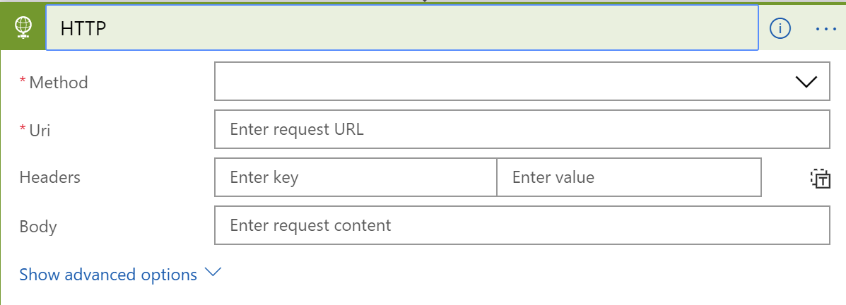
Anatomy of a Logic App
A Logic app can start with a Connector that has a Trigger, or just with a Trigger
Logic apps always start with a Trigger, but may not need a Connector…..
Triggers have Actions that can contain logic to perform work……
Notes:
What are the pieces to a Logic App and how do they work together?
<click> A Logic app can start with a Connector that has a Trigger, or just with a Trigger – A logic app can be created to just do work, and not connect to anything. In this case, it only needs a trigger to start
<click> Logic apps always start with a Trigger, but may not have a Connector – A Logic App does need a trigger to start doing something
<click> Triggers have Actions that can contain logic to perform work – In order for a trigger to do something, it generally, but not always, will have actions. For example a trigger with no action may only be used to start a workflow process…that is the action

Slide 13
Scaling/Pricing
Consumption pricing model
You only pay for what you use
Logic apps meters all actions that run in your logic app
Fixed pricing model
Setup an Integrated Service Environment (ISE) – in private preview
Pay a fixed monthly price for built-in actions and standard ISE-labeled connectors
The ISE includes one free Enterprise connector
ISE link https://docs.microsoft.com/en-us/azure/logic-apps/connect-virtual-network-vnet-isolated-environment-overview
Notes:
https://docs.microsoft.com/en-us/azure/logic-apps/logic-apps-pricing

Slide 14
Connectors
Connectors are hosted services in Azure, deployed and managed by Microsoft
There are currently 200+ connectors available for use and you can build your own connector
Connectors can be added to a Logic App to allow the Logic App to connect to other systems and services
Most Connectors have triggers that allow for starting a process
There are two basic types of connectors
Built-Ins – These are the connectors that you find within the Logic Apps designer to choose from or you can access these connectors via API calls
Managed Connectors – provide triggers and actions for access to other services and Enterprise systems
Notes:
https://docs.microsoft.com/en-us/azure/connectors/connectors-overview

Slide 15
Triggers
Triggers create and run instances of the logic app
Provided triggers
Polling triggers – triggers that poll your service at a specified frequency and checks for new data
Push triggers – listen for new data at an endpoint or for an event to happen, which creates and runs a new instance of the logic app
Recurrence trigger – creates and runs an instance of the logic app on a specified schedule
Notes:
https://docs.microsoft.com/en-us/azure/connectors/apis-list#more-about-triggers-and-actions

Slide 16
Actions
Action – any step(s) that happen after the run has fired from a trigger
Triggers do not provide Actions, Connectors provide Actions
Most connections provide one or more Actions that can be executed as part of a workflow
Not all Connectors have Actions
Notes:
https://docs.microsoft.com/en-us/azure/connectors/connectors-overview#actions

Slide 17
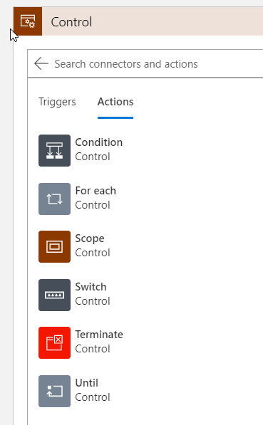
Flow Control
Flow control takes place through Actions
Condition – Identifies which block of actions to execute based on evaluation of an input condition
For each – Executes a block of actions for each item in the input array
Scope – Encapsulate a block of actions and inherit the last terminal status (Succeeded, Failed, Cancelled) of actions inside
Switch – Identifies a single case to execute based on the evaluation of switch input
Terminate – Terminate the execution of a Logic App run
Until – Executes a block of actions until a specified condition evaluates to true
Notes:
To actually see these flow control icons, you need to create a logic app, do something with it and then click New Step. Click on the All menu item and then the Control icon

Slide 18

Demonstration
Creating a Logic App through the Azure Portal
Notes:
See demo instructions at .\Demos\Demo1

Slide 19
Introduction to Logic Apps Logic Apps Development

Slide 20
How would you start development of a Logic App?
The Azure Portal
Visual Studio
Visual Studio Code
Notes:
The 3 basic ways of starting development of a logic app. Since you just did a demo through the portal, the next demo will be through VS code

Slide 21
Logic App development through Visual Studio
Allows you to add your logic app to source control
Allows you to publish different versions of your logic app
Allows you to create an ARM template for different deployment environments
Visual Studio has a Logic App Designer similar to the Azure Portal
Requires Azure Logic Apps Tools for Visual Studio 2017 https://marketplace.visualstudio.com/items?itemName=VinaySinghMSFT.AzureLogicAppsToolsforVisualStudio-18551
Notes:
https://docs.microsoft.com/en-us/azure/logic-apps/quickstart-create-logic-apps-with-visual-studio

Slide 22
Demonstration
Creating a Logic App through Visual Studio
Notes:
See demo instructions at .\Demos\Demo2

Slide 23
Logic App development through Visual Studio Code
Allows you to create and edit logic app workflow definitions
Allows you to work with the workflow definition schema in JSON
Allows you to work on existing logic apps deployed to Azure
Allows you to work faster than in Visual Studio if you are already familiar with the workflow definition
Works with any development platform that VS Code runs on
Notes:
https://docs.microsoft.com/en-us/azure/logic-apps/quickstart-create-logic-apps-with-visual-studio

Slide 24
Demonstration
Creating a Logic App through Visual Studio Code
Notes:
See demo instructions at .\Demos\Demo3

Slide 25
Logic App Variables
Store and work with values using variables in your logic app
Allowed variable types:
Integer
Float
Boolean
String
Array
Object
Variables are global only within the logic app instance that creates them
Variables persist across any loop iterations inside of a logic app instance
Notes:
https://docs.microsoft.com/en-us/azure/logic-apps/logic-apps-create-variables-store-values

Slide 26
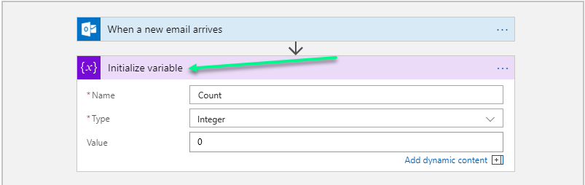
Logic App Variables – con’t
A variable in a logic app requires a Name, Type and Value. Store and work with values using variables in your logic app
Getting a variables value is performed by:
{string(variables(‘mystringname’))}
Initialize a variable by using the Initialize Variable action
Notes:
https://docs.microsoft.com/en-us/azure/logic-apps/logic-apps-create-variables-store-values

Slide 27
Performing Data Operations
Action | Description
Create CSV Table | Create a comma-separated value (CSV) table from an array
Create HTML Table | Create an HTML table from an array
Filter Array | Create an array subset from an array based on the specified filter or condition
Join | Create a string from all items in an array and separate each item with the specified character
Select | Create an array from the specified properties for all the items in a different array
Join | Create a string from all the items in an array and separate each item with the specified character
Parse JSON | Create user-friendly data tokens for properties in JSON content so you can more easily use the properties in your logic app
Compose | Create a message, or string, from multiple inputs that can have various data types. Use this string as a single input
Notes:
https://docs.microsoft.com/en-us/azure/logic-apps/logic-apps-perform-data-operations
This article shows how you can work with data in your logic apps by adding actions for these tasks and more:
Create tables from arrays.
Create arrays from other arrays based on a condition.
Create user-friendly tokens from JavaScript Object Notation (JSON) object properties so you can easily use those properties in your workflow.

Slide 28
Adding custom code with Azure Functions
Extends your logic apps behavior with functions in Node.js or C#
Perform code executions within the logic app workflow
Apply advanced formatting or compute fields in your logic apps
Requirements
Function must be in the same subscription as your logic app
Function must use an HTTP trigger
You need to enable CORS support on the Function
You can call Functions that already exist or build them from within the logic app UI
Notes:
https://docs.microsoft.com/en-us/azure/logic-apps/logic-apps-azure-functions

Slide 29
Demonstration
Using Functions with your Logic App
Notes:
See demo instructions at .\Demos\Demo4

Slide 30
Introduction to Logic Apps Handling Errors and Exceptions

Slide 31
Handling Errors and Exceptions
Retry Policies – minimum level of exception/error handling
Catch and handle failures with the RunAfter property – use each actions RunAfter property to retrieve status of action
Evaluate actions with scopes and their results – grouping together sets of actions and viewing the groups status
Notes:
https://docs.microsoft.com/en-us/azure/logic-apps/logic-apps-exception-handling#azure-diagnostics-and-metrics

Slide 32
Retry Policies
Specifies whether or how the action or trigger retries a request
The request may time out or just fail
A failure would be any request that results in a 408, 429 or 5xx response
Default – this policy sends up to 4 retries at exponentially increasing intervals – scaled by 7.5 seconds, cap between 5 and 45 seconds
Exponential interval – this policy waits a random interval selected from an exponentially growing range before sending the next request
Fixed interval – this policy waits the specified interval before sending the next request
None – Don’t resend the request
Notes:
https://docs.microsoft.com/en-us/azure/logic-apps/logic-apps-exception-handling#retry-policies

Slide 33
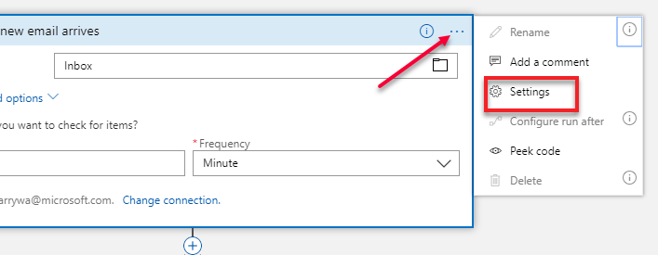
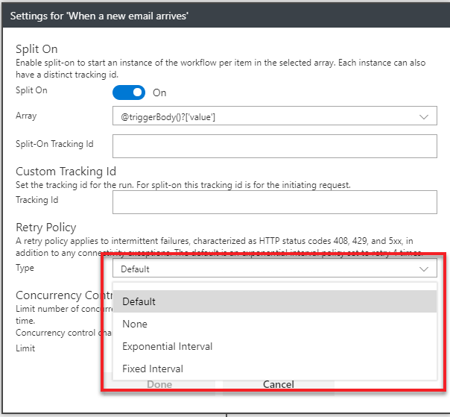
Setting the Retry Policy

Slide 34
Using the RunAfter property
Each Logic apps action declares the previous actions that must finish before the current action starts
Each action definition has a runAfter property that defines the ordering
By default, all actions in a logic app run after the previous steps result is Succeeded
runAfter can be customized to run after Failed, Skipped or a combination of these statuses
Notes:
https://docs.microsoft.com/en-us/azure/logic-apps/logic-apps-exception-handling#retry-policies

Slide 35
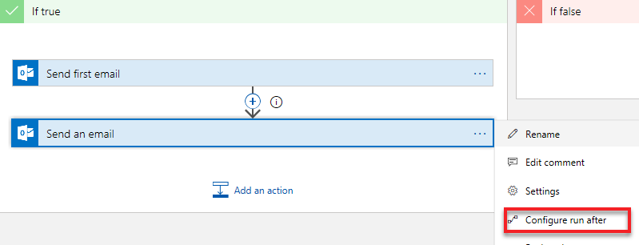
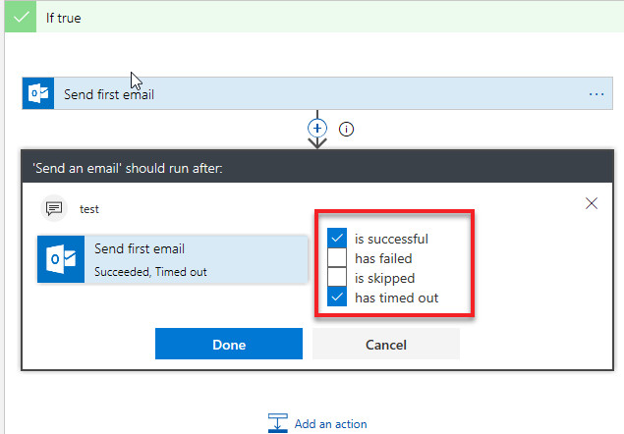
Configure runAfter via the UI
In order for the UI selection to be enabled, the action being configured must be in a scope. In the screenshot, the scope is the true evaluation of a Condition
Notes:
In a normal logic app where you just have one action followed by another, the Configure run after will be disabled because in this case, the next action in the logic app can’t run unless the previous action or trigger works

Slide 36
Evaluating actions with Scopes
Actions can be grouped together inside of a Scope
Good for assessing the aggregate status of a group of actions
After all the actions within the scope are finished, the scope itself gets its own status
A scopes status can be checked the same as a runAfter status, ie, Succeeded, Failed etc.
If the last action in the scope fails, the scopes status is set to Failed
https://docs.microsoft.com/en-us/azure/logic-apps/logic-apps-exception-handling
Notes:
https://docs.microsoft.com/en-us/azure/logic-apps/logic-apps-exception-handling#retry-policies

Slide 37
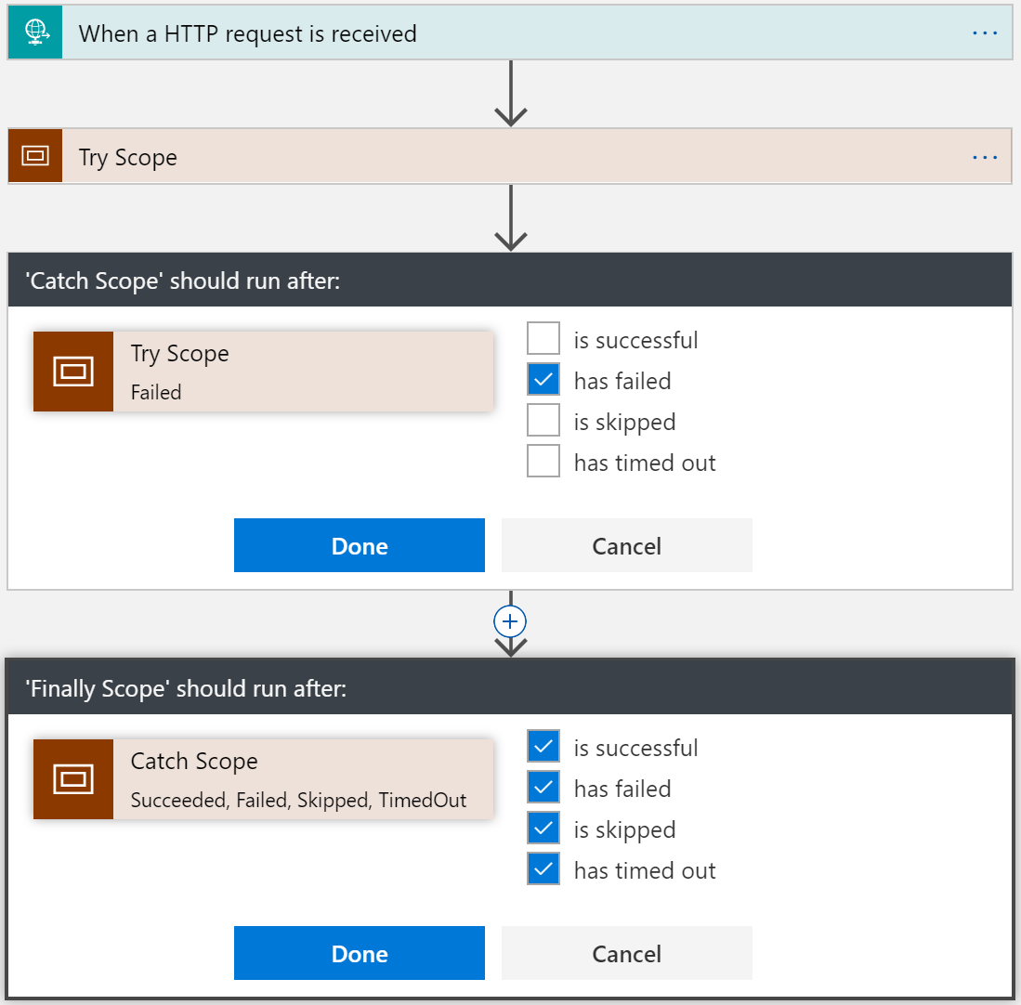
Try-Catch-Finally capability via nested Scopes
Try scope is the outer scope
Two inner scopes, one for catch the other for finally
Inside of the Catch or Finally scope you would have code to determine exception types

Slide 38
Demonstration
Handling Exceptions
Notes:
See demo instructions at .\Demos\Demo2

Slide 39
Microsoft Azure Logic Apps Workflow Definition Language

Slide 40
What is the Workflow Definition Language?
A workflow definition is the underlying definition (description) of what happens in the workflow
This definition has a language structure ‘Workflow Definition Language’ (WDL)
The definition uses JSON and follows a structure that’s validated by the WDL schema
All Logic Apps conform to this schema:
"definition": {
"$schema": "<workflow-definition-language-schema-version>",
"actions": { "<workflow-action-definitions>" },
"contentVersion": "<workflow-definition-version-number>",
"outputs": { "<workflow-output-definitions>" },
"parameters": { "<workflow-parameter-definitions>" },
"staticResults": { "<static-results-definitions>" },
"triggers": { "<workflow-trigger-definitions>" }
}
Notes:
https://docs.microsoft.com/en-us/azure/logic-apps/logic-apps-workflow-definition-language
Why is WDL and the schema important? You have the ability to modify the actual schema of a logic app from code without using the logic app editor and you can create complex expressions

Slide 41
Workflow Definition Language schema elements
Triggers and actions | Defines the calls that happen during the workflow execution
Outputs | Defines the data that your workflow can return when finished running
Parameters | Defines all the workflow parameters that your workflow uses at deployment for accepting inputs
Static results | Defines an action’s mock outputs and status that the action returns. Used for testing logic aps with mock data
Expressions | A sequence that can contain one or more functions, operators, variables, explicit values or constants
Operators | In expressions and functions, operators perform specific tasks such as reference a property or value in an array
Functions | Runtime utilities that is part of the WDL, ie, div()..concat()
Notes:
https://docs.microsoft.com/en-us/azure/logic-apps/logic-apps-workflow-definition-language
Why is WDL and the schema important? You have the ability to modify the actual schema of a logic app from code without using the logic app editor and you can create complex expressions

Slide 42
Workflow Definition Language - Expressions
Expressions can be used for values that don’t exist until run time
Can be used anywhere in a JSON string value by prefixing with @
Evaluation removes the @ character and the results is always JSON
Example:
Incoming JSON: “customerName” : “Bill Gates”
Expression to set a variable named “accountName”:
“accountName” : “@parameters(‘customerName’)”
Notes:
https://docs.microsoft.com/en-us/azure/logic-apps/logic-apps-workflow-definition-language#expressions

Slide 43
Demonstration
View a Logic Apps Workflow Definition
Notes:
Open any function that you’ve created in the portal and select the </> Logic app code view menu item

Slide 44

Lab
Introduction to Logic Apps
Notes:
Lab 2

Slide 45
Introduction to Logic Apps Logic Apps Deployment

Slide 46
Deployment of Logic Apps
Directly through the Azure Portal
ARM Template
Visual Studio tooling
Visual Studio Code tooling
PowerShell – Assumes you have an ARM template placed where cmdlet can reach it
Azure CLI - Assumes you have an ARM template placed where cmdlet can reach it
Azure DevOps
Notes:
https://docs.microsoft.com/en-us/azure/logic-apps/logic-apps-create-deploy-azure-resource-manager-templates

Slide 47
Logic App Deployment templates
Deployment templates consist of:
The Logic App resource – contains information about pricing plan, location and the workflow definition
Workflow definition – describes the logic apps workflow steps and how the workflow should be executed
Connections – separate resources that securely store metadata about the connector connections, ie, connection strings/access tokens
Use Visual Studio Tools for Logic Apps (easiest way – VS2017 only)
Notes:
https://docs.microsoft.com/en-us/azure/logic-apps/logic-apps-create-deploy-azure-resource-manager-templates

Slide 48
Introduction to Logic Apps Logic Apps Monitoring and Troubleshooting
Notes:
https://docs.microsoft.com/en-us/azure/logic-apps/logic-apps-monitor-your-logic-apps
https://docs.microsoft.com/en-us/azure/logic-apps/logic-apps-diagnosing-failures

Slide 49
Monitoring and Diagnostics capabilities
Ability to check logic app Runs and Trigger history – Azure Portal Overview blade
Ability to check logic app current status – Azure Portal Overview blade
Gather logic app execution performance
Enable logic app diagnostics logging – useful for finding information on events
Send alerts based on notifications and failures in the logic app
Notes:
https://docs.microsoft.com/en-us/azure/logic-apps/logic-apps-monitor-your-logic-apps

Slide 50
Diagnostics logging
Diagnostics logging must be turned on
Log Analytics will be used to display the diagnostic information
Log Analytics will display events (trigger, run, action)
Diagnostics information can also be sent to Azure Storage or Event hubs
Notes:
https://docs.microsoft.com/en-us/azure/logic-apps/logic-apps-monitor-your-logic-apps

Slide 51
Setting up Alerts
Used to monitor specific metrics or exceeded thresholds for your logic app
Notes:
https://docs.microsoft.com/en-us/azure/logic-apps/logic-apps-monitor-your-logic-apps

Slide 52
Demonstration
Checking Run and Trigger history
Turning on Diagnostics
Log Analytics
Notes:
See demo instructions at .\Demos\Demo5

Slide 53
Introduction to Logic Apps Logic Apps Security

Slide 54
Securing Logic Apps
Logic apps can provide secure access:
When triggering a logic app workflow with the HTTP request trigger
For managing, editing, or reading a logic app via portal/PowerShell
To the contents inside inputs and outputs for a logic app run
For parameters or inputs for actions in a logic app workflow
To services that receive requests from a logic app workflow

Slide 55
Access to HTTP request triggers
Different ways of securing HTTP request and webhook triggers
Generate shared access signatures
Restrict incoming IP addresses
Add Azure Activity Directory, OAuth or other security (using API Management)

Slide 56
Securing access to the trigger via SAS
Every request endpoint for a logic app includes a Shared Access Signature (SAS) as part of the URL
The signature is generated using the SHA256 algorithm with a secret key on all the URL paths and properties
The logic app only authorizes triggers that contain a valid signature with the secret key
URLs can be generated with specific keys and expiration dates and can be re-generated
Example URL with SAS key
https://prod-40.eastus.logic.azure.com:443/workflows/e3c75bfbb21348e59401701e0143d352/triggers/manual/paths/invoke?api-version=2016-10-01&sp=%2Ftriggers%2Fmanual%2Frun&sv=1.0&sig=D0LNf3uZD_IUCxn65CxTm-56AD2prU-6kO6aGe5Wcz4
Notes:
Describe the lifecycle methods
https://azure.microsoft.com/en-us/documentation/articles/service-fabric-reliable-services-quick-start/

Slide 57
Restricting incoming IP addresses
Restricts calls coming into the logic app to only specific clients
Good for integrating with API Management and locking down calls only from API Management
Setup via ARM Template
{
"properties": {
"definition": {
},
"parameters": {},
"accessControl": {
"triggers": {
"allowedCallerIpAddresses": [
{
"addressRange": "192.168.12.0/23"
},
{
"addressRange": "2001:0db8::/64"
}
]
}
}
},
"type": "Microsoft.Logic/workflows"
}
Notes:
There are many things that a stateless service could be used for, but mostly you would choose it when you are not wanting to store data with the service itself

Slide 58
Access to run history data
During a logic app run, all data is encrypted during transit and at rest
When you view the run history, the actual data passed through (unencrypted), will appear
Logic Apps WILL authenticate your access to the run data
You may want to provide multiple levels of access, ie, be able to see that data but not the passwords or secrets. There are two ways to do this:
Restrict access by IP address range
Hide data from the run history by using obfuscation (next slide)

Slide 59
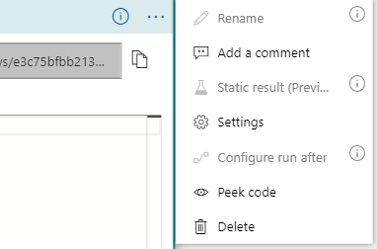
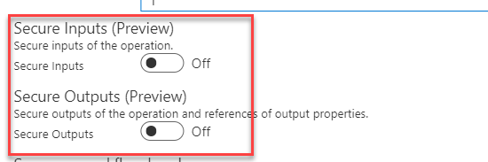
Hiding run data via obfuscation
Notes:
https://docs.microsoft.com/en-us/azure/logic-apps/logic-apps-securing-a-logic-app#hide-data-from-run-history-by-using-obfuscation

Slide 60
Secure access to manage/edit logic apps
Performed by using Role Based Access Control (RBAC) in Azure
RBAC has two specific roles for logic apps (you can also create your own custom role)
Logic App Contributor – provides access to view, edit and update a logic app. No removal or admin operation permissions
Logic App Operator – can view the logic app and run history, and enable/disable the logic app. Cannot edit or update definition

Slide 61
Secure parameters and inputs within the logic app
A logic app workflow definition provides a @parameters() operation for normal unsecure parameters
Modify the parameter type as securestring to make it secure
The parameter won’t be returned with the rest of the resource definition and won’t be accessible by viewing the resource deployment
https://docs.microsoft.com/en-us/azure/logic-apps/logic-apps-securing-a-logic-app#secure-parameters-and-inputs-within-a-workflow
Notes:
https://docs.microsoft.com/en-us/azure/logic-apps/logic-apps-securing-a-logic-app#secure-parameters-and-inputs-within-a-workflow

Slide 62
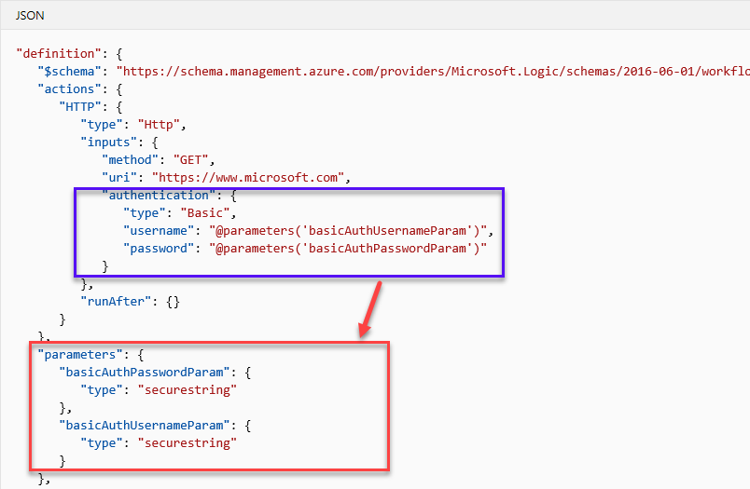
Secure parameters example

Slide 63
Managed Identities in Logic Apps
Used to allow a logic app the access resources in other Azure Active Directory (AAD) tenants
Authenticates your identity without signing in whether within the same AAD tenant or accessing another AAD tenant
Logic apps can use a managed identity instead of a credential or secret
Can be setup either through the portal or via ARM template
Notes:
https://docs.microsoft.com/en-us/azure/logic-apps/create-managed-service-identity

Slide 64
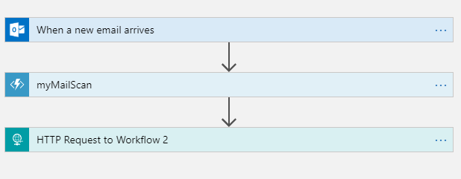
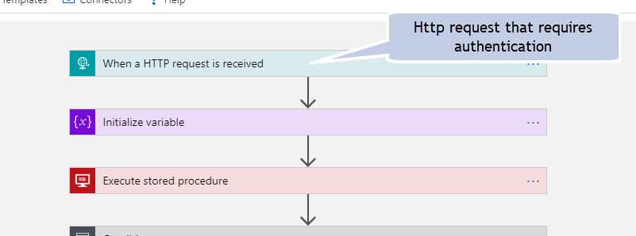
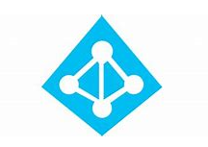
Managed Identity in use – workflow to workflow
1. A managed identity is created in AAD
Workflow 1
2. Both logic apps are assigned access to
the managed identity
3. When Workflow 1 calls Workflow 2,
the managed identity is used for
authenticating the call
Workflow 2

Slide 65
Introduction to Logic Apps Enterprise Integration

Slide 66
What is Enterprise Integration?
“…the practice of system interconnection, electronic data exchange, product data exchange and distributed computing environments…

Slide 67
…but more specifically..
Exchanging the following types of data between business partners
AS2
X12
EDIFACT
XML
JSON
…
The practice of storing all such artifacts in one location….an integration account
Notes:
Primarily,

Slide 68
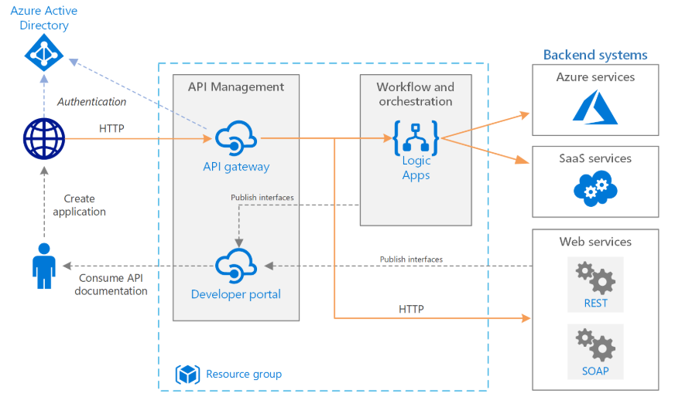
Enterprise Integration scenario
Notes:
https://docs.microsoft.com/en-us/azure/architecture/reference-architectures/enterprise-integration/basic-enterprise-integration
Architecture
The architecture has the following components:
Backend systems. The right-hand side of the diagram shows the various backend systems that the enterprise has deployed or relies on. These might include SaaS systems, other Azure services, or web services that expose REST or SOAP endpoints.
Azure Logic Apps. Logic Apps is a serverless platform for building enterprise workflows that integrate applications, data, and services. In this architecture, the logic apps are triggered by HTTP requests. You can also nest workflows for more complex orchestration. Logic Apps uses connectors to integrate with commonly used services. Logic Apps offers hundreds of connectors, and you can create custom connectors.
Azure API Management. API Management is a managed service for publishing catalogs of HTTP APIs, to promote reuse and discoverability. API Management consists of two related components:
API gateway. The API gateway accepts HTTP calls and routes them to the backend.
Developer portal. Each instance of Azure API Management provides access to a developer portal. This portal gives your developers access to documentation and code samples for calling the APIs. You can also test APIs in the developer portal.
In this architecture, composite APIs are built by importing logic apps as APIs. You can also import existing web services by importing OpenAPI (Swagger) specifications or importing SOAP APIs from WSDL specifications.
The API gateway helps to decouple front-end clients from the back end. For example, it can rewrite URLs, or transform requests before they reach the backend. It also handles many cross-cutting concerns such as authentication, cross-origin resource sharing (CORS) support, and response caching.
Azure DNS. Azure DNS is a hosting service for DNS domains. Azure DNS provides name resolution by using the Microsoft Azure infrastructure. By hosting your domains in Azure, you can manage your DNS records by using the same credentials, APIs, tools, and billing that you use for your other Azure services. To use a custom domain name, such as contoso.com, create DNS records that map the custom domain name to the IP address. For more information, see Configure a custom domain name in API Management.
Azure Active Directory (Azure AD). Use Azure AD to authenticate clients that call the API gateway. Azure AD supports the OpenID Connect (OIDC) protocol. Clients obtain an access token from Azure AD, and API Gateway validates the token to authorize the request. When using the Standard or Premium tier of API Management, Azure AD can also secure access to the developer portal.

Slide 69
Common terminology for Enterprise Integration
Agreements | Certificates
Flat file encoding/decoding | Integration accounts
Maps | Partners
Schemas | XML message validation
EDI | XML transform
Enterprise Integration connectors | Integration Account Metadata
https://docs.microsoft.com/en-us/azure/logic-apps/logic-apps-enterprise-integration-overview
Notes:
Primarily,

Slide 70
Integration Accounts
You must have an Integration Account before you can build true B2B solutions with Logic Apps
An Integration Account allows you to create, store and manage B2B artifacts like
Trading Partners
Agreements
Maps
Schemas
Certificates
Batch configurations
RosettaNet PIP
Assemblies
Once the Integration account is created, you will then link your logic app to the integration account to access the artifacts
Notes:
https://docs.microsoft.com/en-us/azure/logic-apps/logic-apps-enterprise-integration-create-integration-account

Slide 71
What’s in an Integration Account?.
Partners | Entities that participate in B2B transactions and exchange messages with each other
Agreements | Helps partners communicate with each other by defining specific industry standard protocol to use when exchanging B2B messages
Batch configuration | Partners often exchange messages in batches – you can setup batch parameters here
Schemas | A description of structure, format and data type of the type of documents involved in a transaction
Maps | An XSLT representation of the path of data transformation between two schemas
Assemblies | Assemblies can include maps, schemas and other artifacts
Certificates | Used for message communication security
RosettaNet PIP | Supply chain standard practices along with Partner Interface Processes (PIP) ~ common business definitions
Notes:
Agreements - https://docs.microsoft.com/en-us/azure/logic-apps/logic-apps-enterprise-integration-agreements
Trading Partners - https://docs.microsoft.com/en-us/azure/logic-apps/logic-apps-enterprise-integration-partners
Batching - https://docs.microsoft.com/en-us/azure/logic-apps/logic-apps-scenario-edi-send-batch-messages
RosettaNet PIP - https://docs.microsoft.com/en-us/azure/logic-apps/logic-apps-enterprise-integration-rosettanet

Slide 72
Integration Account pricing model
Free – For when you want to try exploratory scenarios
Basic – For when you only want message handling or to act as a small business partner that works with a larger business partner
Standard – For when you have more complex B2B relationships and increased numbers of entities that you must manage
Notes:
Primarily,

Slide 73
Demonstration
Creating an Integration account
Notes:
Create an integration account and link it with a Logic App

Slide 74
Lab
Enterprise Integration with Logic Apps
Notes:
Lab 2

Slide 75
Introduction to Logic Apps Integrated Service Environment

Slide 76
Integration Service Environment
Used for scenarios where your logic apps and integration accounts need access to an Azure Virtual Network
A private and isolated environment that uses dedicated storage and other resources
Dedicated resources reduces impact that may be caused by other Azure tenants
Azure injects the ISE into your virtual network, you can then create your logic apps in the ISE
An ISE increases:
Run duration
Storage retention
Http request and response timeouts
Message sizes
Custom connector requests
Notes:
https://docs.microsoft.com/en-us/azure/logic-apps/connect-virtual-network-vnet-isolated-environment

Slide 77
ISE specific connectors
Azure Blob Storage, File Storage and Table Storage
Azure Queues, Azure Service Bus, Azure Event Hubs and IBM MQ
FTP and SFTP-SSH
SQL Server, SQL Data Warehouse, Azure Cosmos DB
AS2, X12 and EDIFACT
Built in triggers and actions always run in the same ISE as your logic app
Notes:
https://docs.microsoft.com/en-us/azure/logic-apps/connect-virtual-network-vnet-isolated-environment

Slide 78
ISE - things to think about
You need to create a Virtual Network and this network needs 4 empty subnets
If you’re going to use a custom DNS, you need to set this up ahead of time
A variety of ports will need to be opened to allow traffic from the virtual network to the ISE environment
For all of the above, you need to work with your IT/Operations/Networking team to secure IP address ranges, port permissions
An ISE is expensive!
Developer ~ $1.03 per hour
Premium ~ $6.64 per hour + scaling unit costs
Notes:
https://docs.microsoft.com/en-us/azure/logic-apps/connect-virtual-network-vnet-isolated-environment

Slide 79
Resources
Logic Apps Documentation
https://docs.microsoft.com/en-us/azure/logic-apps/
http://aka.ms/ServiceFabric
Logic Apps Team blog
https://blogs.msdn.microsoft.com/logicapps/
Logic Apps Videos
https://www.youtube.com/channel/UCbJQweD96Y7n-ebKpdLDJww
Logic Apps limits and configuration
https://docs.microsoft.com/en-us/azure/logic-apps/logic-apps-limits-and-config

